Slide 1

OOSA&D(2017) 06 封装调用: 命令模式
06 Encapsulating Invocation: the Command Pattern

Slide 2
Glossary
invoke调用, Invocation, Invoker
method invocation方法调用
feature特色
slot插槽
execute执行
command命令
remote control遥控
Dalian Neusoft University of Information © Copyright

Slide 3
Agenda
A Case Analysis
Design Pattern: The Command Pattern
An Application for example
An experiment in class
Practices of design pattern as homework
Dalian Neusoft University of Information © Copyright

Slide 4
Agenda
A Case Analysis
Design Pattern: The Command Pattern
An Application for example
An experiment in class
Practices of design pattern as homework
Dalian Neusoft University of Information © Copyright

Slide 5
1. A Case Analysis
A case of remote control
Build a remote that will control variety of home devices
Sample devices: lights, stereo, TV, ceiling light, thermostat, sprinkler, hot tub, garden light, ceiling fan, garage door
Dalian Neusoft University of Information © Copyright

Slide 6
1. A Case Analysis
home automation P192
Free hardware! Let’s check out the Remote Control...
Dalian Neusoft University of Information © Copyright

Slide 7
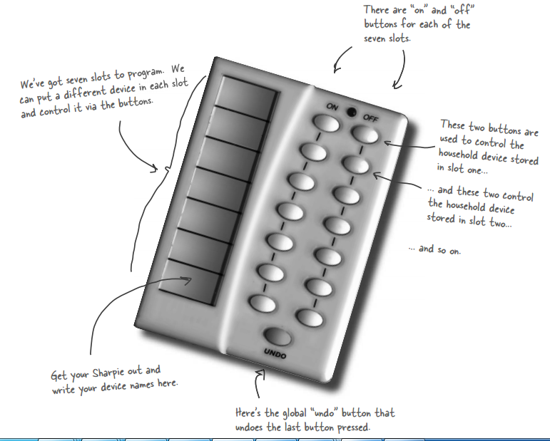
1. A Case Analysis
Dalian Neusoft University of Information © Copyright

Slide 8

1. A Case Analysis
Taking a look at the vendor classes
Check out the vendor classes on the CD-R. These should give you some idea of the interfaces of the objects we need to control from the remote.
Dalian Neusoft University of Information © Copyright

Slide 9
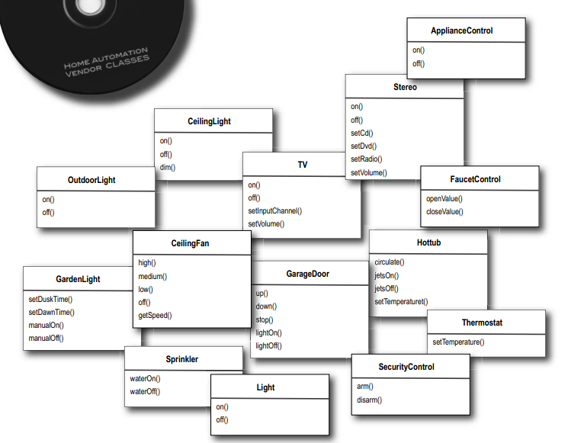
1. A Case Analysis
Dalian Neusoft University of Information © Copyright

Slide 10

1. A Case Analysis
Your teammates are already discussing how to design the remote control API...
Well, we’ve got another design to do.
My first observation is that we’ve got a
simple remote with on and off buttons but
a set of vendor classes that are quite
diverse.
Dalian Neusoft University of Information © Copyright

Slide 11

1. A Case Analysis
Hey, I couldn’t help overhearing. Since Chapter 1 I’ve been boning up on Design Patterns. There’s a pattern called “Command Pattern” I think might help
Dalian Neusoft University of Information © Copyright

Slide 12

1. A Case Analysis
Meanwhile, back at the Diner..., or, A brief introduction to the Command Pattern.
let’s take a short detour back to the diner and study the interactions between the customers, the waitress, the orders and the short-order cook. Through these interactions, you’re going to understand the objects involved in the Command Pattern and also get a feel for how the decoupling works. After that, we’re going to knock out that remote control API.
Dalian Neusoft University of Information © Copyright

Slide 13
1. A Case Analysis
Okay, we all know how the Diner operates:
Dalian Neusoft University of Information © Copyright

Slide 14
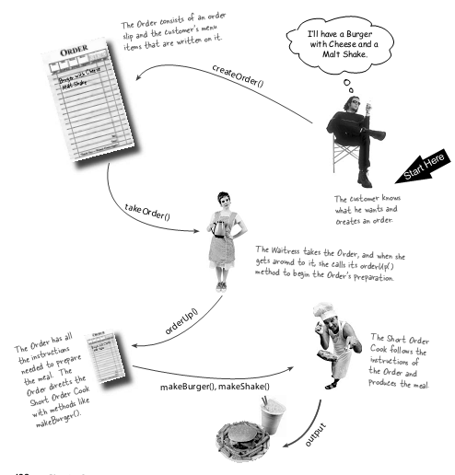
1. A Case Analysis
Let’s study the interaction in a little more detail...
Dalian Neusoft University of Information © Copyright

Slide 15
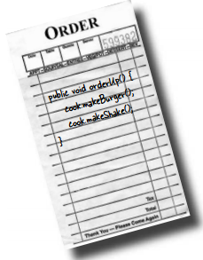
1. A Case Analysis
The Objectville Diner roles and responsibilities
An Order Slip encapsulates a request to prepare a meal.
Dalian Neusoft University of Information © Copyright

Slide 16
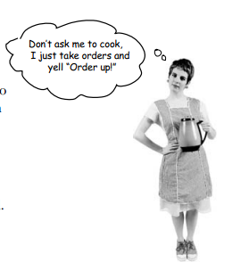
1. A Case Analysis
The Objectville Diner roles and responsibilities
The Waitress’s job is to take Order Slips and invoke the orderUp() method on them.
Dalian Neusoft University of Information © Copyright

Slide 17
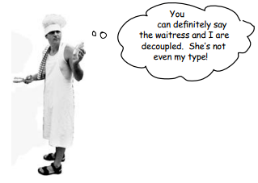
1. A Case Analysis
The Objectville Diner roles and responsibilities
The Short Order Cook has the knowledge required to prepare the meal.
Dalian Neusoft University of Information © Copyright

Slide 18
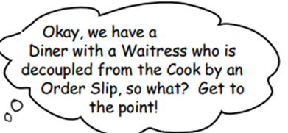
1. A Case Analysis
Dalian Neusoft University of Information © Copyright

Slide 19
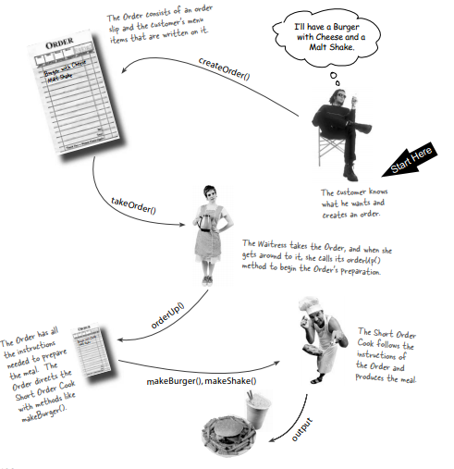
1. A Case Analysis
Before we move on, spend some time studying the diagram two pages back along with Diner roles and responsibilities until you think you’ve got a handle on the Objectville Diner objects and relationships. Once you’ve done that, get ready to nail the Command Pattern!
Dalian Neusoft University of Information © Copyright

Slide 20
1. A Case Analysis
From the Diner to the Command Pattern
Okay, we’ve spent enough time in the Objectville Diner that we know all the personalities and their responsibilities quite well. Now we’re going to rework the Diner diagram to reflect the Command Pattern. You’ll see that all the players are the same; only the names have changed.
Dalian Neusoft University of Information © Copyright

Slide 21
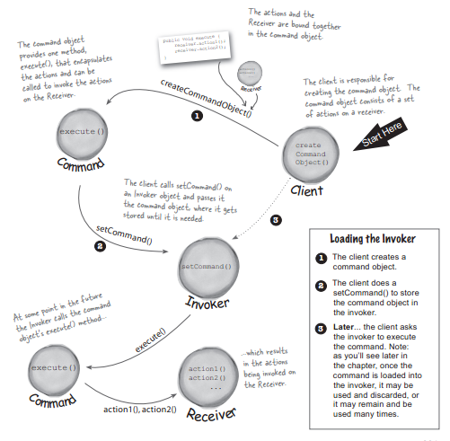
1. A Case Analysis
Dalian Neusoft University of Information © Copyright

Slide 22
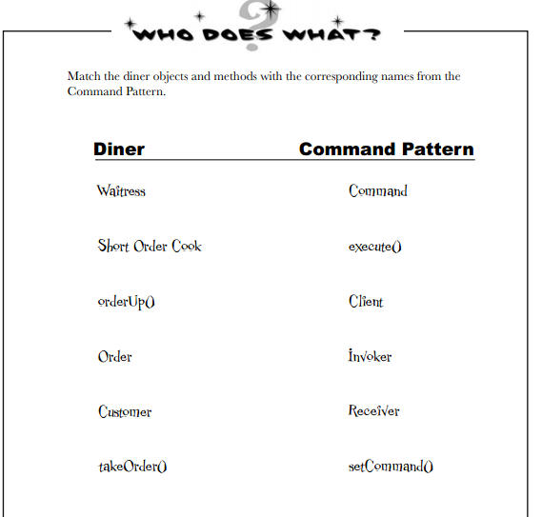
1. A Case Analysis
Dalian Neusoft University of Information © Copyright

Slide 23
1. A Case Analysis
Our first command object
Implementing the Command interface
public interface Command {
public void execute();
}

Slide 24

1. A Case Analysis
Implementing a Command to turn a light
public class LightOnCommand implements Command {
Light light;
public LightOnCommand(Light light) {
this.light = light;
}
public void execute() {
light.on();
}
}

Slide 25
1. A Case Analysis
Using the command object
public class SimpleRemoteControl {
Command slot;
public SimpleRemoteControl() {}
public void setCommand(Command command) {
slot = command;
}
public void buttonWasPressed() {
slot.execute();
}
}

Slide 26

1. A Case Analysis
Creating a simple test to use the Remote Control
public class RemoteControlTest {
public static void main(String[] args) {
SimpleRemoteControl remote = new SimpleRemoteControl();
Light light = new Light();
LightOnCommand lightOn = new LightOnCommand(light);
remote.setCommand(lightOn);
remote.buttonWasPressed();
}
}

Slide 27
1. A Case Analysis
GarageDoorOpenCommand class(P205)

Slide 28
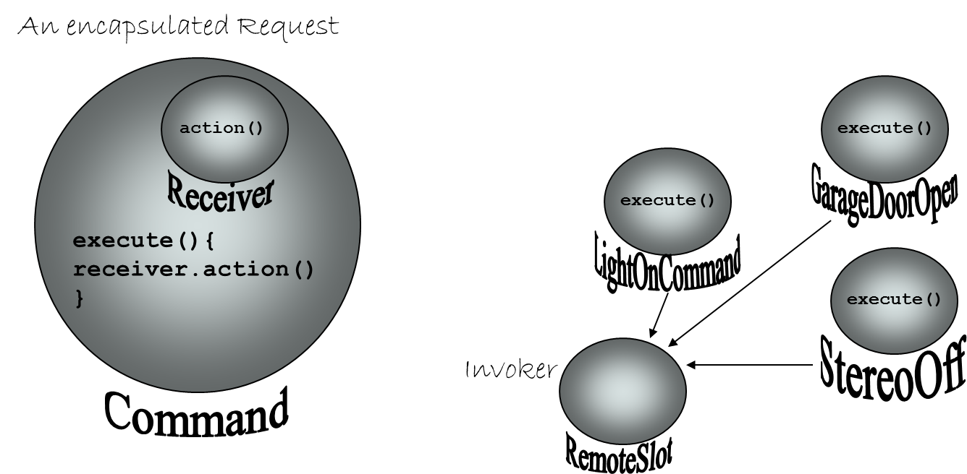
1. A Case Analysis
Command Pattern for home automation
Dalian Neusoft University of Information © Copyright

Slide 29
Agenda
A Case Analysis
Design Pattern: The Command Pattern
An Application for example
An experiment in class
Practices of design pattern as homework
Dalian Neusoft University of Information © Copyright

Slide 30
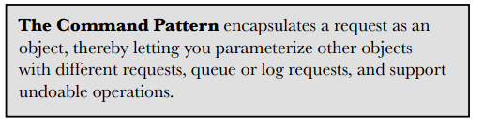

2. Design Pattern
Dalian Neusoft University of Information © Copyright

Slide 31
模式动机
在软件设计中，我们经常需要向某些对象发送请求，但是并不知道请求的接收者是谁，也不知道被请求的操作是哪个，我们只需在程序运行时指定具体的请求接收者即可，此时，可以使用命令模式来进行设计，使得请求发送者与请求接收者消除彼此之间的耦合，让对象之间的调用关系更加灵活。

Slide 32
模式动机
命令模式可以对发送者和接收者完全解耦，发送者与接收者之间没有直接引用关系，发送请求的对象只需要知道如何发送请求，而不必知道如何完成请求。这就是命令模式的模式动机。

Slide 33
2. Design Pattern
Command Pattern Class Diagram
命令模式包含如下角色：
Command: 抽象命令类
ConcreteCommand: 具体命令类
Invoker: 调用者
Receiver: 接收者
Client:客户类
Dalian Neusoft University of Information © Copyright

Slide 34
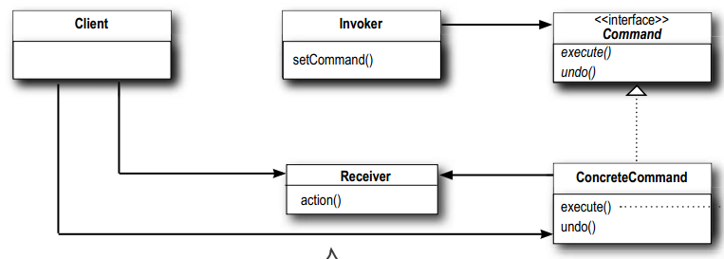
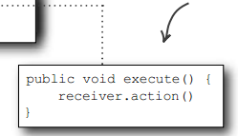
2. Design Pattern
Command Pattern Class Diagram
Dalian Neusoft University of Information © Copyright

Slide 35
模式分析
命令模式的本质是对命令进行封装，将发出命令的责任和执行命令的责任分割开。
每一个命令都是一个操作：请求的一方发出请求，要求执行一个操作；接收的一方收到请求，并执行操作。
命令模式允许请求的一方和接收的一方独立开来，使得请求的一方不必知道接收请求的一方的接口，更不必知道请求是怎么被接收，以及操作是否被执行、何时被执行，以及是怎么被执行的。
命令模式使请求本身成为一个对象，这个对象和其他对象一样可以被存储和传递。
命令模式的关键在于引入了抽象命令接口，且发送者针对抽象命令接口编程，只有实现了抽象命令接口的具体命令才能与接收者相关联。

Slide 36
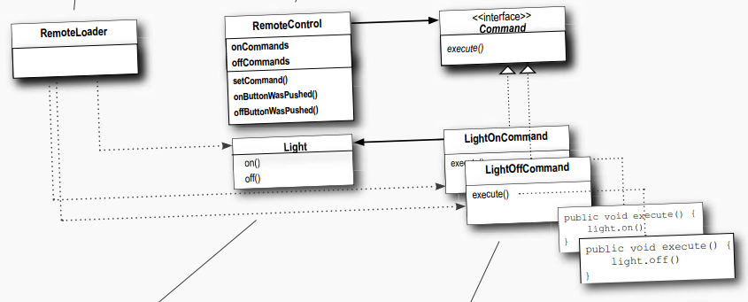
2. Design Pattern
Command Pattern Class Diagram for Home automation
Dalian Neusoft University of Information © Copyright

Slide 37
2. Design Pattern
Implementing the Remote Control API
In our case we have seven slots, each with an “on” and “off” button. So we might assign commands to the remote something like this:
onCommands[0] = onCommand;
offCommands[0] = offCommand;

Slide 38
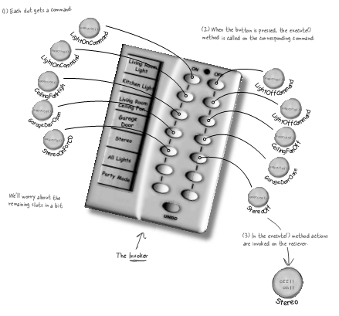
2. Design Pattern
Assigning Commands to slots
We’re going to assign each slot to a command in the remote control. This makes the remote control our invoker . When a button is pressed the execute() method is going to be called on the corresponding command, which results in actions being invoked on the receiver (like lights, ceiling fans, stereos).

Slide 39
2. Design Pattern
Implementing the Remote Control (1)
public class RemoteControl {
Command[] onCommands;
Command[] offCommands;
public RemoteControl() {
onCommands = new Command[7];
offCommands = new Command[7];
Command noCommand = new NoCommand();
for (int i = 0; i < 7; i++) {
onCommands[i] = noCommand;
offCommands[i] = noCommand;
}
}

Slide 40
2. Design Pattern
Implementing the Remote Control(2)
public class RemoteControl {
Command[] onCommands;
Command[] offCommands;
public RemoteControl() {
onCommands = new Command[7];
offCommands = new Command[7];
Command noCommand = new NoCommand();
for (int i = 0; i < 7; i++) {
onCommands[i] = noCommand;
offCommands[i] = noCommand;
}
}

Slide 41
2. Design Pattern
Implementing the Remote Control(3)
public String toString() {
StringBuffer stringBuff = new StringBuffer();
stringBuff.append(“\n------ Remote Control -------\n”);
for (int i = 0; i < onCommands.length; i++) {
stringBuff.append(“[slot “ + i + “] “ + onCommands[i].getClass().getName()
+ “ “ + offCommands[i].getClass().getName() + “\n”);
}
return stringBuff.toString();
}
}

Slide 42
2. Design Pattern
Implementing the Commands
public class LightOffCommand implements Command {
Light light;
public LightOffCommand(Light light) {
this.light = light;
}
public void execute() {
light.off();
}
}

Slide 43
2. Design Pattern
Putting the Remote Control through its paces(1)
public class RemoteLoader {
public static void main(String[] args) {
RemoteControl remoteControl = new RemoteControl();
Light livingRoomLight = new Light(“Living Room”);
Light kitchenLight = new Light(“Kitchen”);
CeilingFan ceilingFan= new CeilingFan(“Living Room”);
GarageDoor garageDoor = new GarageDoor(“”);
Stereo stereo = new Stereo(“Living Room”);
LightOnCommand livingRoomLightOn = new LightOnCommand(livingRoomLight);
LightOffCommand livingRoomLightOff = new LightOffCommand(livingRoomLight);
LightOnCommand kitchenLightOn = new LightOnCommand(kitchenLight);
LightOffCommand kitchenLightOff = new LightOffCommand(kitchenLight);
CeilingFanOnCommand ceilingFanOn = new CeilingFanOnCommand(ceilingFan);
CeilingFanOffCommand ceilingFanOff = new CeilingFanOffCommand(ceilingFan);
GarageDoorUpCommand garageDoorUp = new GarageDoorUpCommand(garageDoor);
GarageDoorDownCommand garageDoorDown = new GarageDoorDownCommand(garageDoor);
StereoOnWithCDCommand stereoOnWithCD = new StereoOnWithCDCommand(stereo);
StereoOffCommand stereoOff = new StereoOffCommand(stereo);

Slide 44
2. Design Pattern
Putting the Remote Control through its paces(2)
LightOnCommand livingRoomLightOn =new LightOnCommand(livingRoomLight);
LightOffCommand livingRoomLightOff =new LightOffCommand(livingRoomLight);
LightOnCommand kitchenLightOn = new LightOnCommand(kitchenLight);
LightOffCommand kitchenLightOff = new LightOffCommand(kitchenLight);
CeilingFanOnCommand ceilingFanOn = new CeilingFanOnCommand(ceilingFan);
CeilingFanOffCommand ceilingFanOff = new CeilingFanOffCommand(ceilingFan);
GarageDoorUpCommand garageDoorUp = new GarageDoorUpCommand(garageDoor);
GarageDoorDownCommand garageDoorDown = new GarageDoorDownCommand(garageDoor);
StereoOnWithCDCommand stereoOnWithCD = new StereoOnWithCDCommand(stereo);
StereoOffCommand stereoOff = new StereoOffCommand(stereo);

Slide 45
2. Design Pattern
Putting the Remote Control through its paces(3)
remoteControl.setCommand(0, livingRoomLightOn, livingRoomLightOff);
remoteControl.setCommand(1, kitchenLightOn, kitchenLightOff);
remoteControl.setCommand(2, ceilingFanOn, ceilingFanOff);
remoteControl.setCommand(3, stereoOnWithCD, stereoOff);
System.out.println(remoteControl);
remoteControl.onButtonWasPushed(0);
remoteControl.offButtonWasPushed(0);
remoteControl.onButtonWasPushed(1);
remoteControl.offButtonWasPushed(1);
remoteControl.onButtonWasPushed(2);
remoteControl.offButtonWasPushed(2);
remoteControl.onButtonWasPushed(3);
remoteControl.offButtonWasPushed(3);
}}

Slide 46
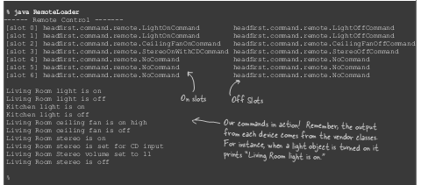
2. Design Pattern
the execution of our remote control test

Slide 47


2. Design Pattern
NoCommand
public class NoCommand implements Command {
public void execute() { }
}

Slide 48
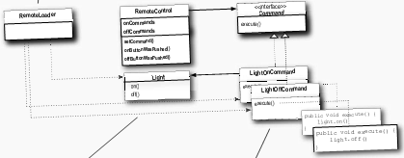
2. Design Pattern
Time to write that documentation...

Slide 49
2. Design Pattern
THE UNDO BUTTON!!!
When commands support undo, they have an undo() method that mirrors the execute() method. Whatever execute() last did, undo() reverses. So, before we can add undo to our commands, we need to add an undo() method to the Command interface
public interface Command {
public void execute();
public void undo();
}

Slide 50
2. Design Pattern
THE UNDO BUTTON!!!
Let’s start with the LightOnCommand: if the LightOnCommand’s execute() method was called, then the on() method was last called. We know that undo() needs to do the opposite of this by calling the off() method.
public class LightOnCommand implements Command {
Light light;
public LightOnCommand(Light light) {
this.light = light;
}
public void execute() {
light.on();
}
public void undo() {
light.off();
}
}

Slide 51
2. Design Pattern
THE UNDO BUTTON!!!
To add support for the undo button we only have to make a few small changes to the Remote Control class. Here’s how we’re going to do it: we’ll add a new instance variable to track the last command invoked; then, whenever the undo button is pressed, we retrieve that command and invoke its undo() method.

Slide 52
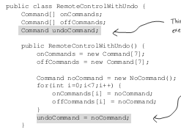
2. Design Pattern
THE UNDO BUTTON!!!

Slide 53
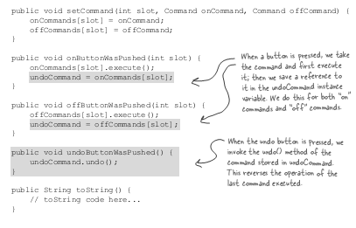
2. Design Pattern
THE UNDO BUTTON!!!

Slide 54
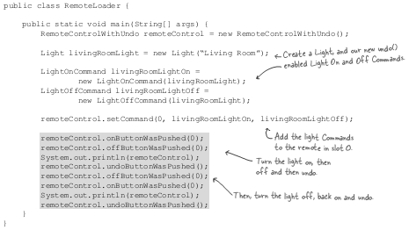
2. Design Pattern
Test Undo button

Slide 55
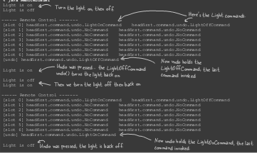
2. Design Pattern
Test Undo button

Slide 56

2. Design Pattern
public void high() {
speed = HIGH;
// code to set fan to high
}
public void medium() {
speed = MEDIUM;
// code to set fan to medium
}
public void low() {
speed = LOW;
// code to set fan to low
}
public void off() {
speed = OFF;
// code to turn fan off
}
public int getSpeed() {
return speed;
}
}
Using state to implement Undo
public class CeilingFan {
public static fi nal int HIGH = 3;
public static fi nal int MEDIUM = 2;
public static fi nal int LOW = 1;
public static fi nal int OFF = 0;
String location;
int speed;
public CeilingFan(String location) {
this.location = location;
speed = OFF;
}

Slide 57
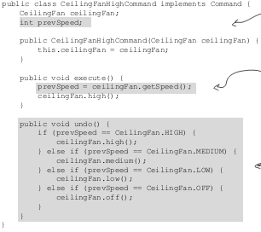

2. Design Pattern
Adding Undo to the ceiling fan commands

Slide 58
2. Design Pattern
Get ready to test the ceiling fan
public class RemoteLoader {
public static void main(String[] args) {
RemoteControlWithUndo remoteControl = new RemoteControlWithUndo();
CeilingFan ceilingFan = new CeilingFan(“Living Room”);
CeilingFanMediumCommand ceilingFanMedium = new CeilingFanMediumCommand(ceilingFan);
CeilingFanHighCommand ceilingFanHigh = new CeilingFanHighCommand(ceilingFan);
CeilingFanOffCommand ceilingFanOff = new CeilingFanOffCommand(ceilingFan);
remoteControl.setCommand(0, ceilingFanMedium, ceilingFanOff);
remoteControl.setCommand(1, ceilingFanHigh, ceilingFanOff);
remoteControl.onButtonWasPushed(0);
remoteControl.offButtonWasPushed(0);
System.out.println(remoteControl);
remoteControl.undoButtonWasPushed();
remoteControl.onButtonWasPushed(1);
System.out.println(remoteControl);
remoteControl.undoButtonWasPushed();
}
}

Slide 59
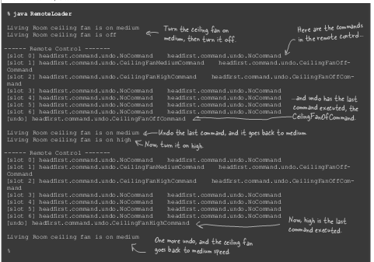
2. Design Pattern
Testing the ceiling fan...

Slide 60
2. Design Pattern
Testing the ceiling fan...

Slide 61
2. Design Pattern
Testing the ceiling fan...

Slide 62
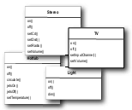
2. Design Pattern
Every remote needs a Party Mode!
public class MacroCommand implements Command {
Command[] commands;
public MacroCommand(Command[] commands) {
this.commands = commands;
}
public void execute() {
for (int i = 0; i < commands.length; i++) {
commands[i].execute();
}
}
}

Slide 63
2. Design Pattern
Using a macro command
First we create the set of commands we want to go into the macro:
Light light = new Light(“Living Room”);
TV tv = new TV(“Living Room”);
Stereo stereo = new Stereo(“Living Room”);
Hottub hottub = new Hottub();
LightOnCommand lightOn = new LightOnCommand(light);
StereoOnCommand stereoOn = new StereoOnCommand(stereo);
TVOnCommand tvOn = new TVOnCommand(tv);
HottubOnCommand hottubOn = new HottubOnCommand(hottub);

Slide 64
2. Design Pattern
Using a macro command
Next we create two arrays, one for the On commands and one for the Off com-mands, and load them with the corresponding commands:
Command[] partyOn = { lightOn, stereoOn, tvOn, hottubOn};
Command[] partyOff = { lightOff, stereoOff, tvOff, hottubOff};
MacroCommand partyOnMacro = new MacroCommand(partyOn);
MacroCommand partyOffMacro = new MacroCommand(partyOff);

Slide 65
2. Design Pattern
Using a macro command
Then we assign MacroCommand to a button like we always do:
remoteControl.setCommand(0, partyOnMacro, partyOffMacro);

Slide 66
2. Design Pattern
Using a macro command
Finally, we just need to push some buttons and see if this works.
System.out.println(remoteControl);
System.out.println(“--- Pushing Macro On---”);
remoteControl.onButtonWasPushed(0);
System.out.println(“--- Pushing Macro Off---”);
remoteControl.offButtonWasPushed(0);

Slide 67
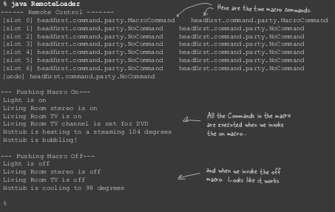
2. Design Pattern

Slide 68
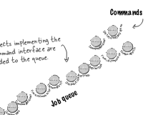
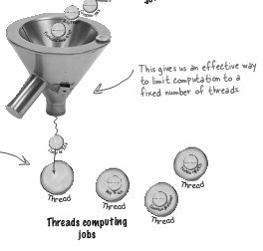
2. Design Pattern
More uses of the Command Pattern: queuing requests

Slide 69
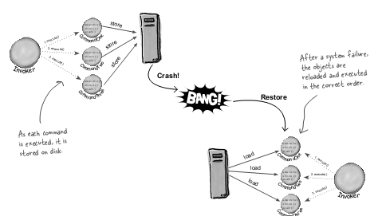
2. Design Pattern
More uses of the Command Pattern: logging requests

Slide 70
Agenda
A Case Analysis
Design Pattern: The Command Pattern
An Application for example
An experiment in class
Practices of design pattern as homework
Dalian Neusoft University of Information © Copyright

Slide 71
3. An Application for example
The TV remote control:
电视机是请求的接收者，遥控器是请求的发送者，遥控器上按钮对应电视机的三种操作：打开电视机（ turn on the TV ）、关闭电视机（ turn off the TV ）和切换频道（switch channels）。运用命令模式对电视机遥控器进行设计。
Your job is to…
Design the class diagram
program according to your class diagram
Test your design with turn on, turn off and change channel.
Dalian Neusoft University of Information © Copyright

Slide 72
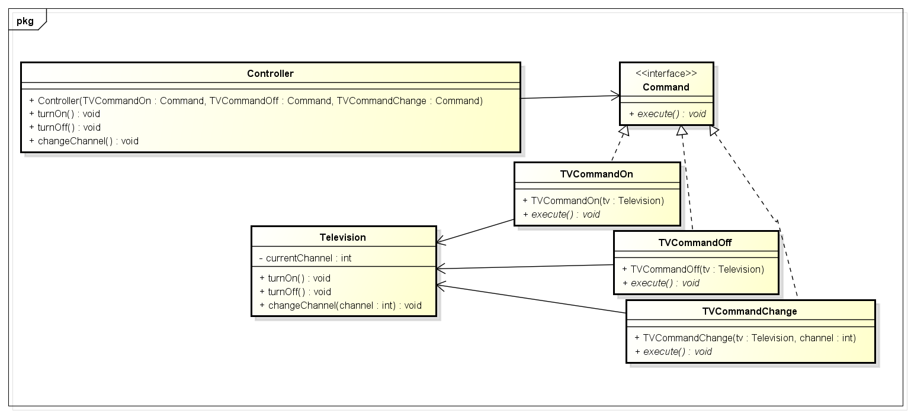
3. An Application for example
A TV with different operations Class Diagram

Slide 73
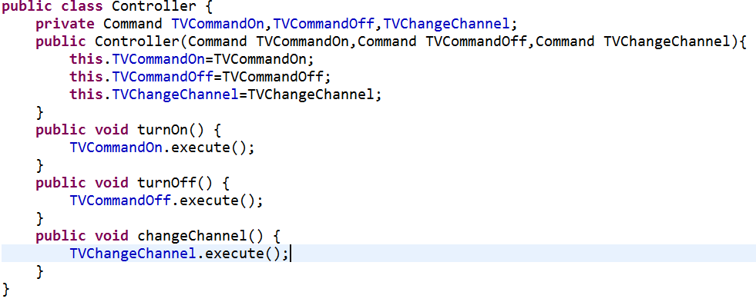
3. An Application for example

Slide 74

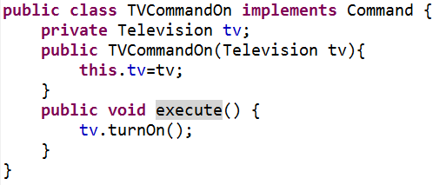
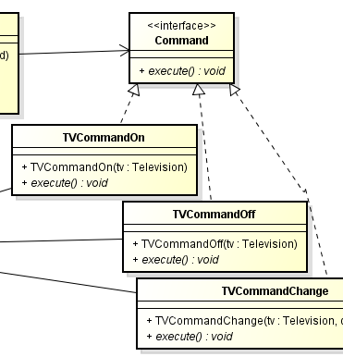
3. An Application for example

Slide 75
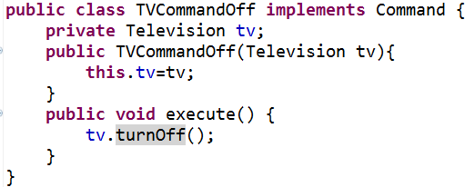
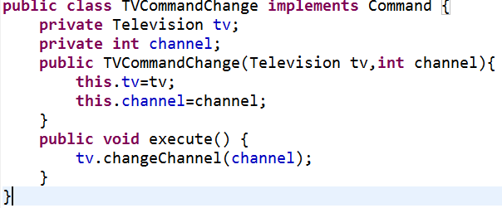
3. An Application for example

Slide 76
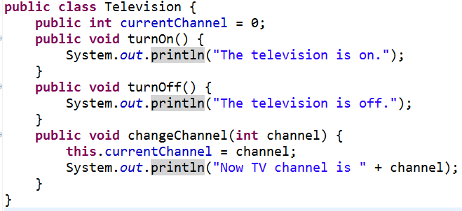
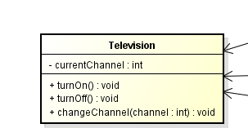
3. An Application for example

Slide 77
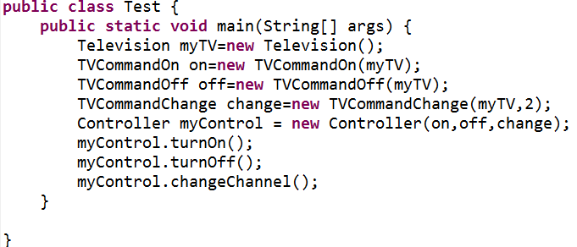

3. An Application for example
Console output:

Slide 78
4. An experiment in class
A Barbecue shop system
客户要求服务员（Servant）点烤羊肉串（MuttonString）或者鸡肉（Chicken），厨师（Chef）负责烧烤。
Your job is to…
Design the class diagram
program according to your class diagram
Test your design with the order of one mutton string and one chicken.
Dalian Neusoft University of Information © Copyright

Slide 79
Agenda
A Case Analysis
Design Pattern: The Command Pattern
An Application for example
An experiment in class
Practices of design pattern as homework
Dalian Neusoft University of Information © Copyright

Slide 80
Agenda
A Case Analysis
Design Pattern: The Command Pattern
An Application for example
An experiment in class
Practices of design pattern as homework
Dalian Neusoft University of Information © Copyright

Slide 81
5. Homework
Finish the homework, which includes 3 tasks.
Dalian Neusoft University of Information © Copyright

Slide 82
Summary so far..
OO Basics
Abstraction
Encapsulation
Inheritance
Polymorphism
OO Principles
Encapsulate what varies
Favor composition over inheritance
Program to interfaces not to implementations
Strive for loosely coupled designs between objects that interact
Classes should be open for extension but closed for modification.
Depend on abstracts. Do not depend on concrete classes.

Slide 83
Summary so far…
OO Patterns
Strategy Pattern defines a family of algorithms, Encapsulates each one, and makes them interchangeable. Strategy lets the algorithm vary independently from clients that use it.
Observer Pattern defines a one-to-many dependency between objects so that when one object changes state, all of its dependents are notified and updated automatically.
Decorator Pattern – attach additional responsibilities to an object dynamically. Decorators provide a flexible alternative for sub-classing for extending functionality
Abstractor Factory – Provide an interface for creating families of related or dependent objects without specifying their concrete classes.
Factory Method – Define an interface for creating an object, but let subclasses decide which class to instantiate. Factory method lets a class defer instantiation to the subclasses.
Command Pattern – Encapsulates a request as an object, thereby letting you parameterize clients with different requests, queue or log requests, and support undoable operations.

Slide 84
Checkpoints
What is command pattern?
What is the purpose of command pattern?
How to apply command pattern to multithreading environment?

